Slide 1
Examples of Elija’s output for paper:
Learning to pronounce first words in three languages: an investigation of caregiver and infant behavior using a computational model of an infant
Ian S. Howard^{1,2} & Piers Messum³
¹Centre for Robotics and Neural Systems, Plymouth University, Plymouth PL4 8AA, UK.
²Computational and Biological Learning Lab, University of Cambridge, CB2 1PZ United Kingdom.
³Pronunciation Science Ltd, 112 Warner Road, London SE5 9HQ, UK.

Slide 2
Architecture of Elija

Slide 3

Interpretation of discovered vowels
Vowel quadrilateral
/i/
Front
Back /u/
Close
Open
/ae/

Slide 4
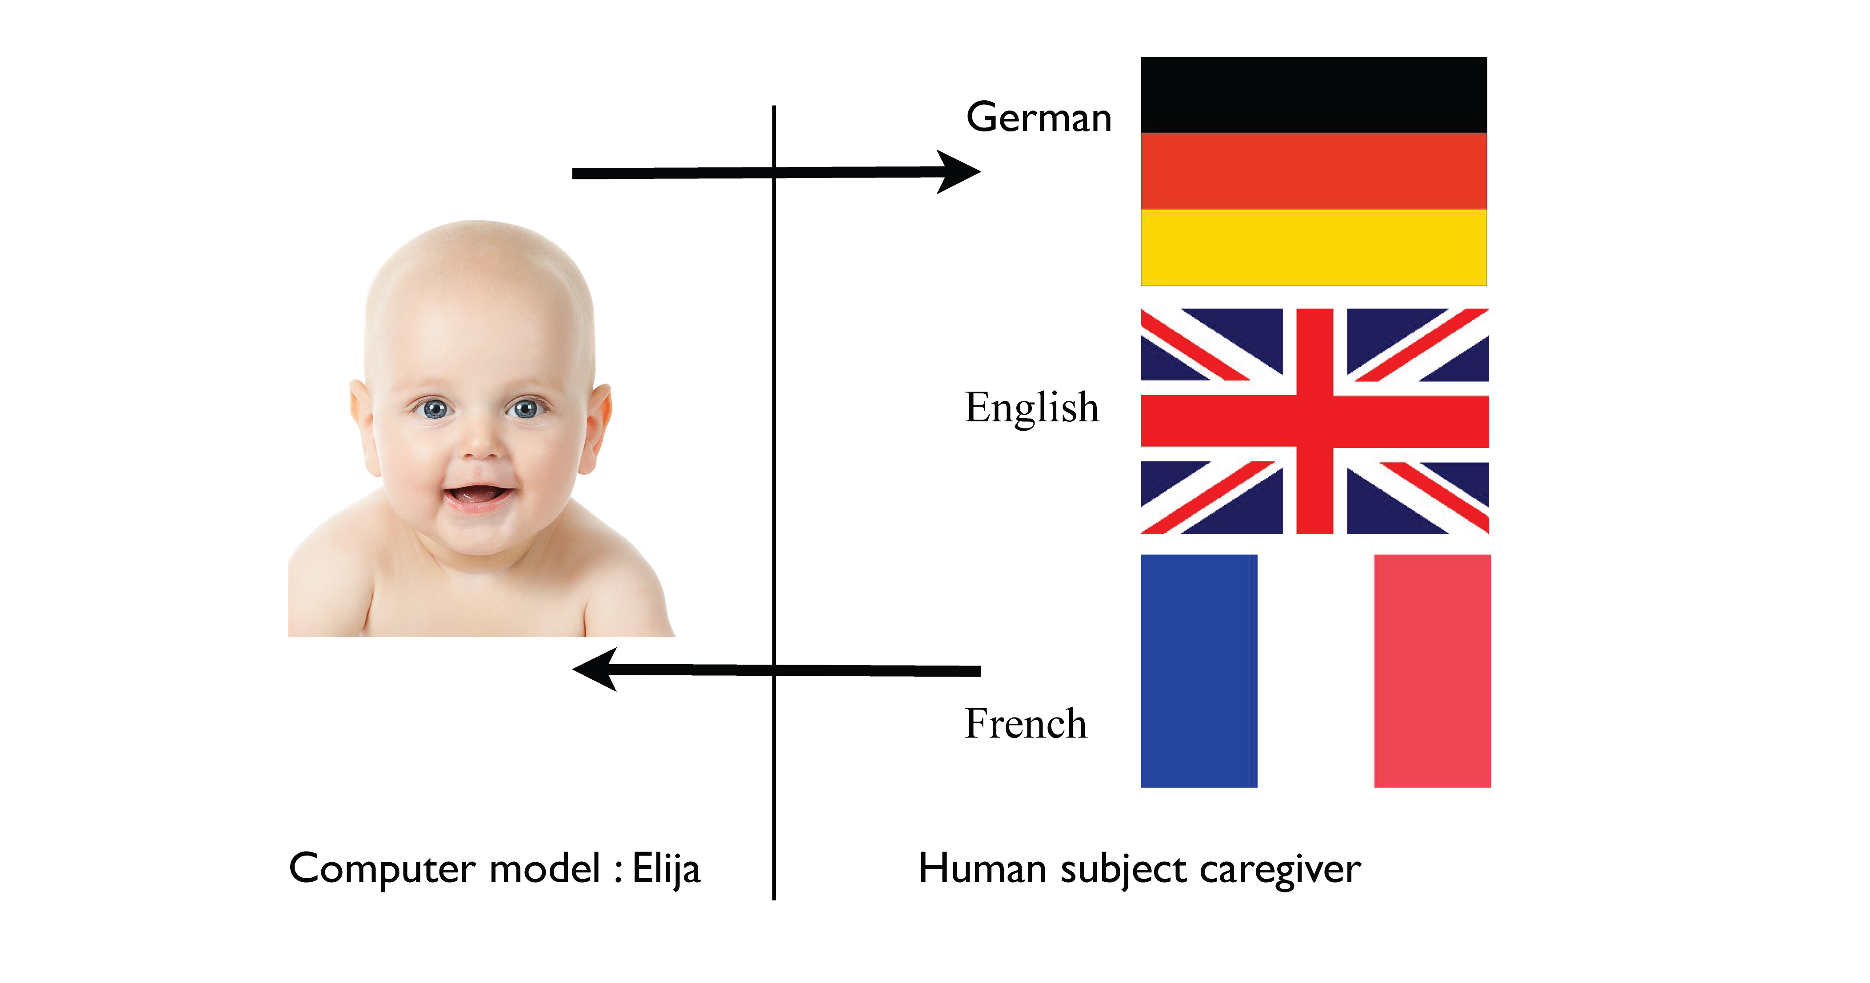
Reformulation Experiments

Slide 5
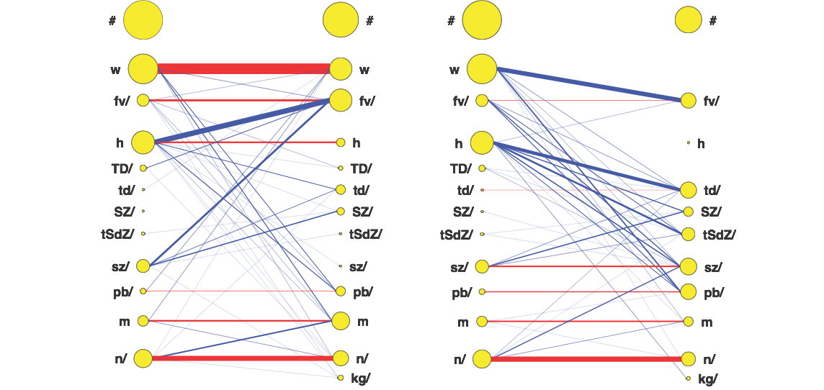

Reformulation consonant comparison
across caregivers
English - English
English - German

Slide 6
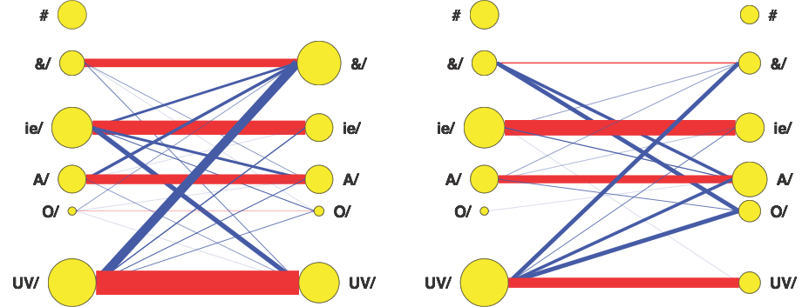
Reformulation vowel comparison across caregivers
English - English
English - German

Slide 7
Example reformulations
Single pass through potentially useful VMSs
Caregivers interpret Elija and reformulate with L1 sounds
Elija | German | Canadian French | American English
Reformulation for same sounds language dependent

Slide 8
Word learning experiments

Slide 9
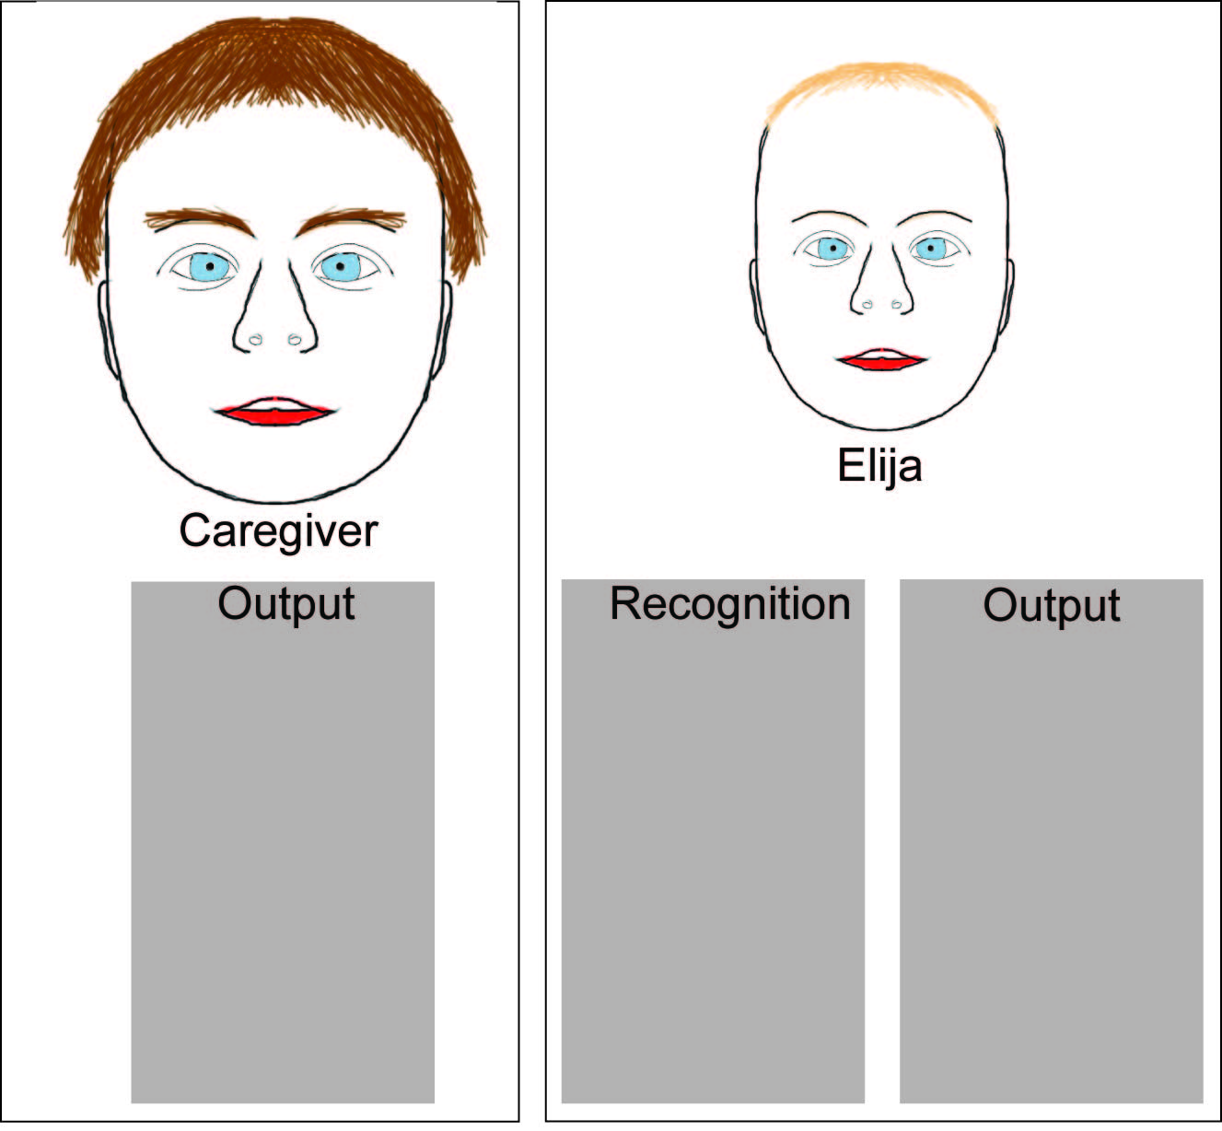
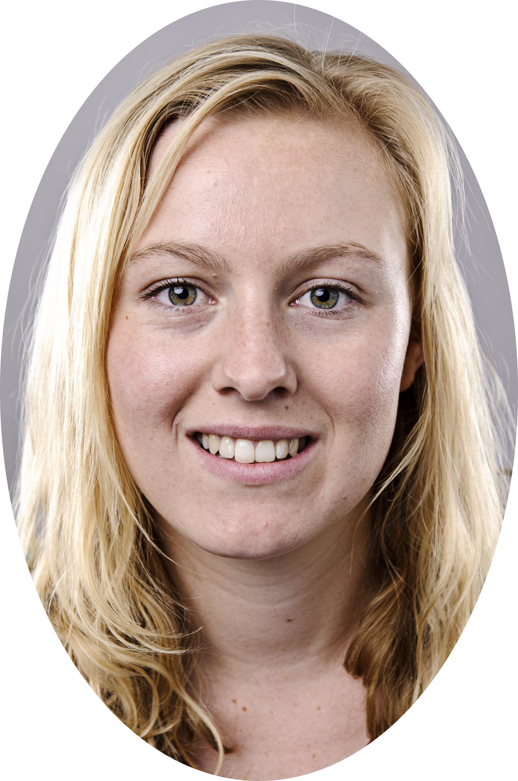
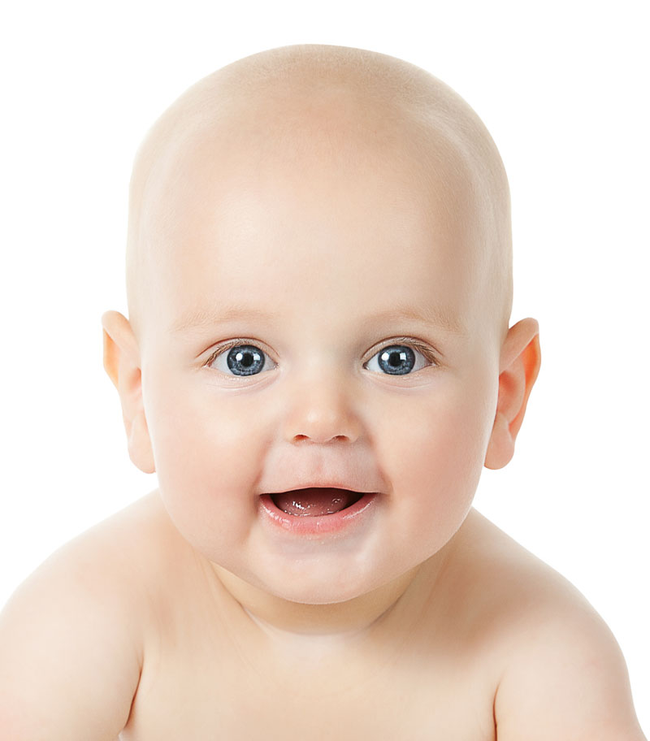
Iterative interaction

Slide 10
Example Imitations
French
English
Word | Caregiver | Elija
Couteau
Lait
Gâteau
Popo
Fourchette
Word | Caregiver | Elija
Chair
Cherries
Keys
Eye
Beaker
German
Word | Caregiver | Elija
Auto
Kerze
Hase
Papi
Schuh

